Slide 1
Iso-Seq Bioinformatics Template
Elizabeth Tseng, Pacific Biosciences, Dec 2019

Slide 2
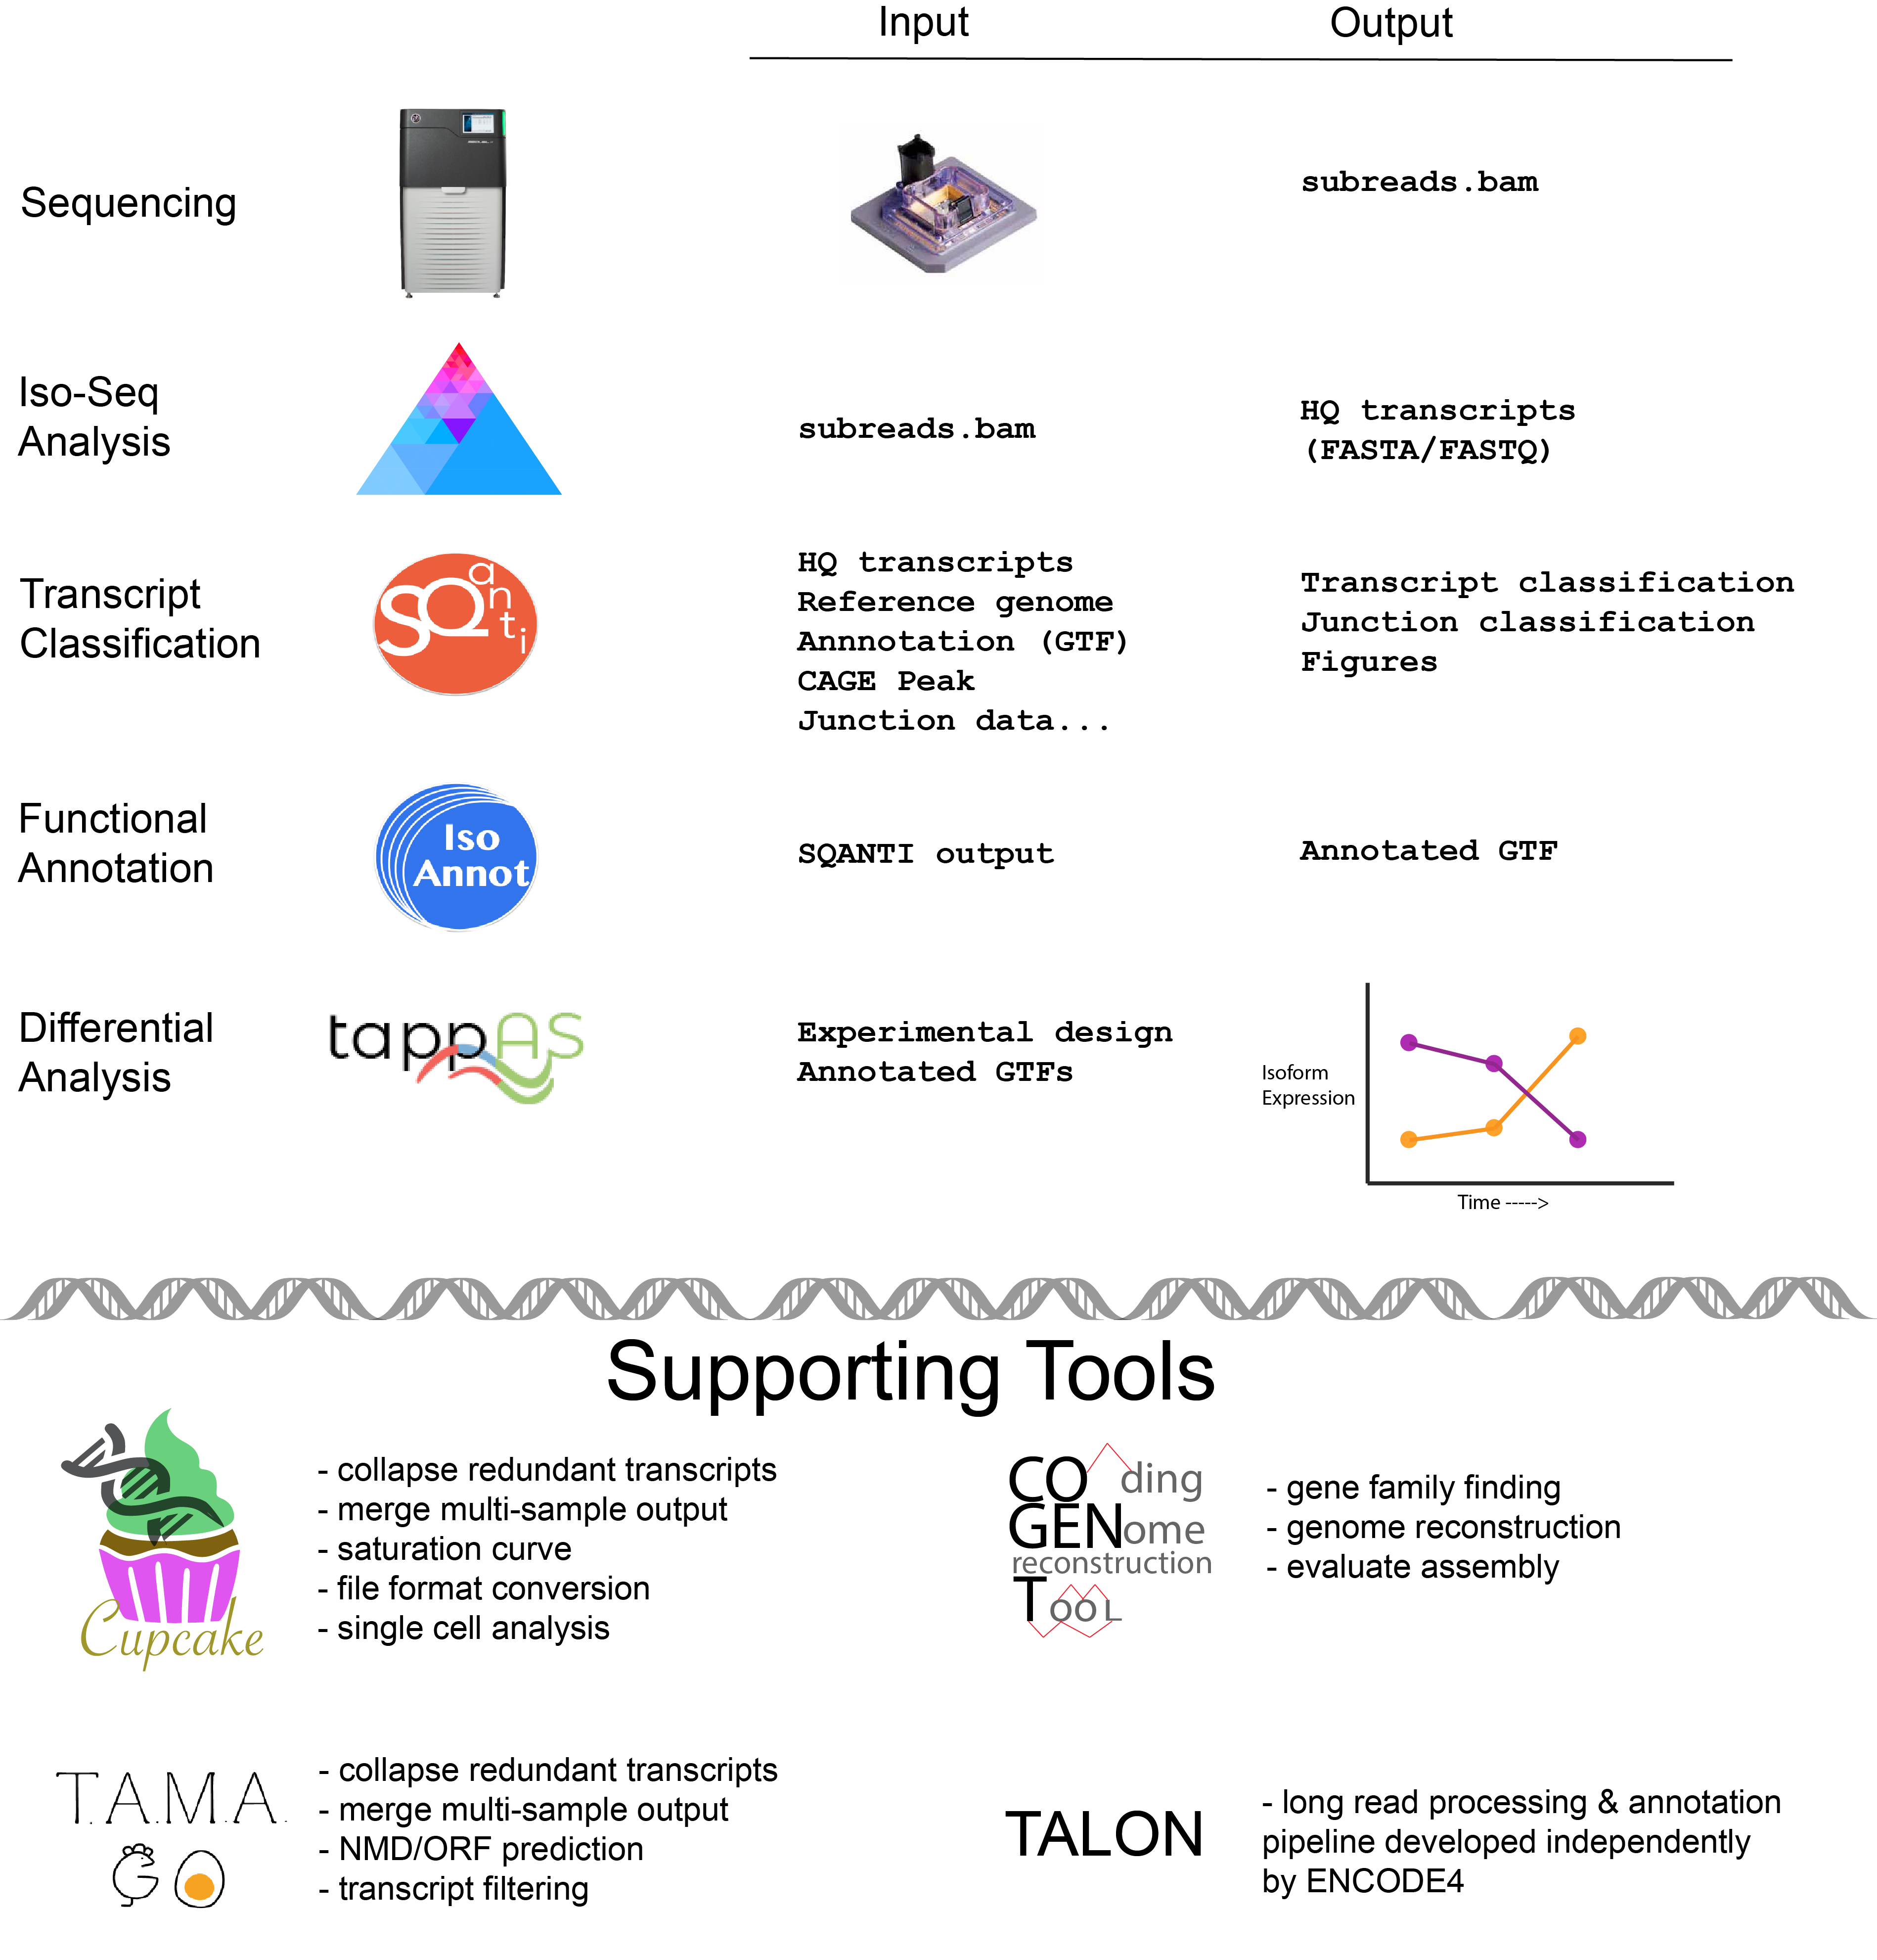

Slide 3
Template contents
Raw data tracksheet
Sequencing summary
Iso-Seq (SMRT Link or BioConda), mapping and collapse summary
SQANTI2 quality control report
Rarefaction curves

Slide 4
Raw data tracksheet
Always keep the raw data!
UHRR_cell1/4_D01/
├── m53579_999999_111111.adapters.fasta
├── m53579_999999_111111.controls.adapters.fasta
├── m53579_999999_111111.controls.fasta
├── m53579_999999_111111.scraps.bam
├── m53579_999999_111111.scraps.bam.pbi
├── m53579_999999_111111.sts.xml
├── m53579_999999_111111.subreads.bam
├── m53579_999999_111111.subreads.bam.pbi
├── m53579_999999_111111.subreadset.xml
Alzheimer/3_C01/
├── m53579_999999_222222.adapters.fasta
├── m53579_999999_222222.controls.adapters.fasta
├── m53579_999999_222222.controls.fasta
├── m53579_999999_222222.scraps.bam
├── m53579_999999_222222.scraps.bam.pbi
├── m53579_999999_222222.sts.xml
├── m53579_999999_222222.subreads.bam
├── m53579_999999_222222.subreads.bam.pbi
├── m53579_999999_222222.subreadset.xml

Slide 5
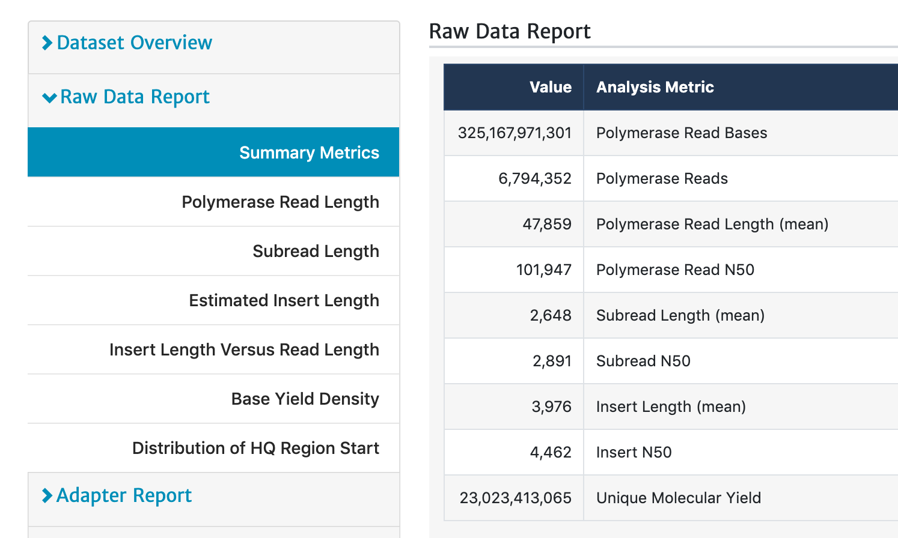
Sequencing summary
Sample | Pol Reads | Pol RL (mean) | Pol RL (N50) | Insert RL (mean) | Insert RL (N50)
UHRR | 6,196,279 | 70 kb | 140 kb | 5.5 kb | 6.1 kb
Alzheimer | 6,794,352 | 48 kb | 102 kb | 4.0 kb | 4.5 kb
Sequencing summary obtained from SMRT Link
Data Management

Slide 6
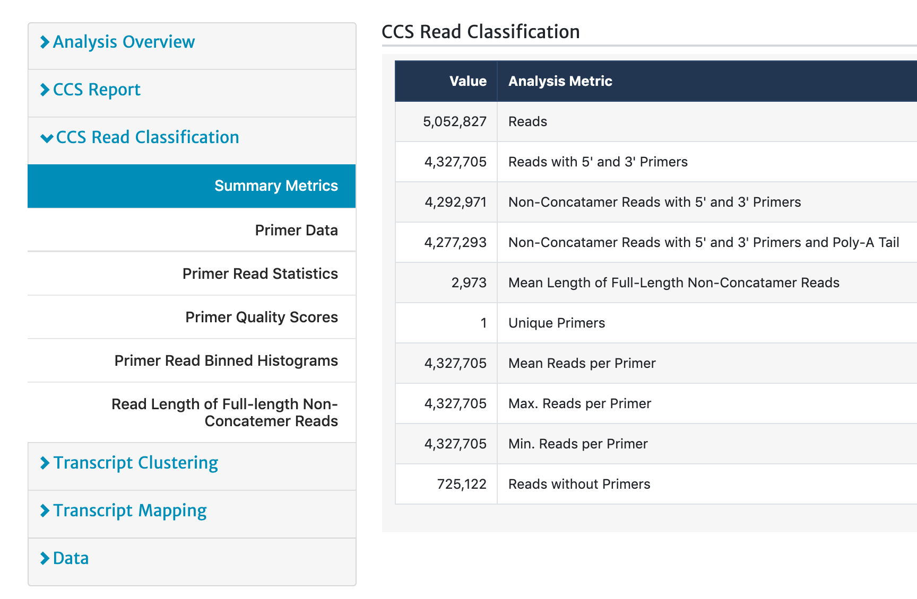
Iso-seq summary: classify
Classify summary from IsoSeq in SMRT Link
CCS
Classify
Generate HiFi reads
Classify Full-Length
Detect & remove cDNA primers
Detect & remove polyA tail
Sample | CCS Reads | FLNC Reads | FLNC Length
UHRR | 4,687,934 | 3,944,419 | 4.5 kb
Alzheimer | 5,052,827 | 4,277,293 | 2.9 kb

Slide 7
Iso-seq summary: cluster & collapse
CCS
Classify
Cluster
Map & Collapse
(optional)
Generate HiFi reads
Classify Full-Length
Detect & remove cDNA primers
Detect & remove polyA tail
Cluster FL reads
Generate consensus
Map to genome
Collapse to unique transcripts
Sample | Unique Loci* | Unique Transcripts
UHRR | 15,060 | 138,622
Alzheimer | 21,563 | 270,205
* Unique loci is not exactly unique genes but non-overlapping transcribed regions
Use SQANTI2 + annotation to determine known/novel genes/transcripts

Slide 8


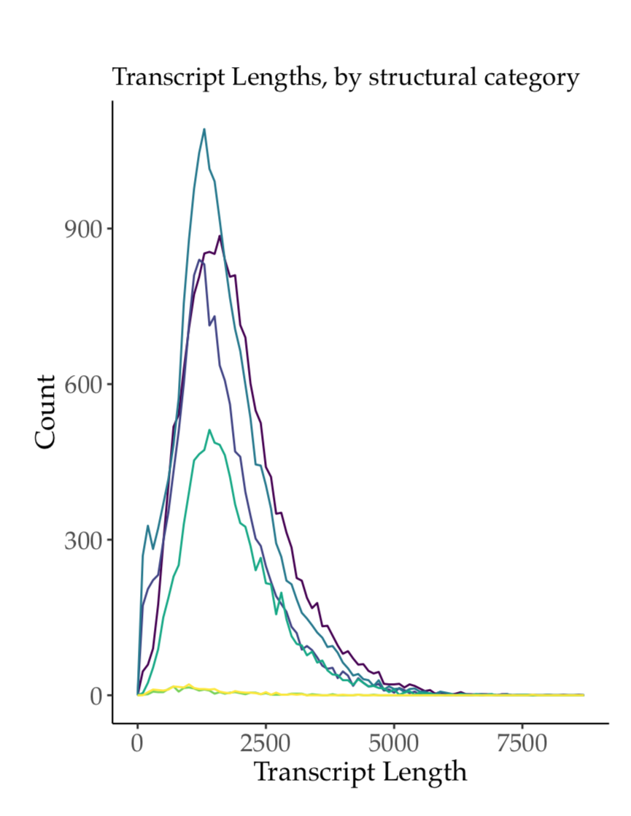
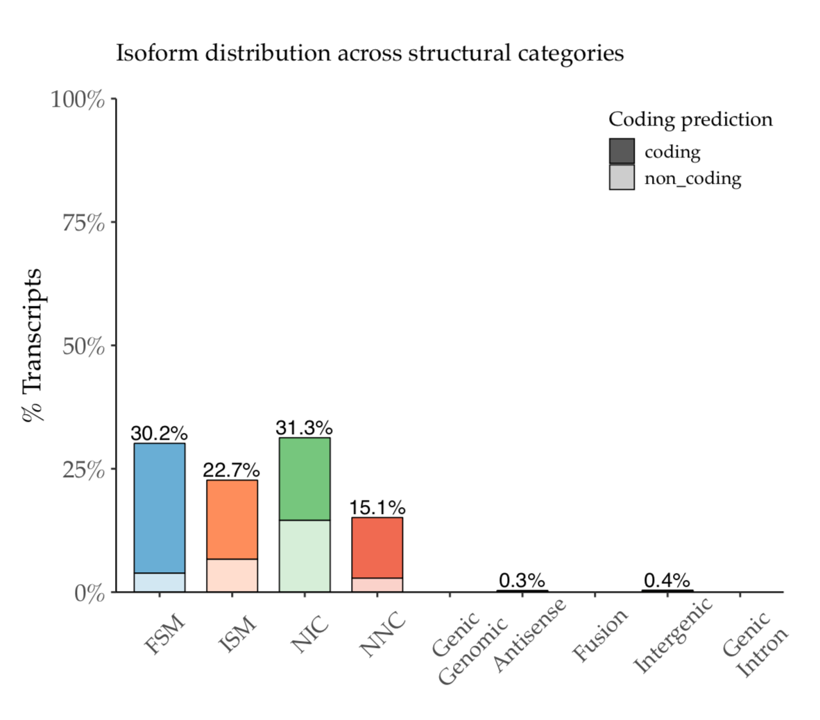
SQANTI2: classifying full-length transcripts
Transcripts
Classification Report
FASTA/FASTQ
ID Gene Transcript Category
PB.1.2
PB.1.3
PB.2.1
PB.3.1
ENST0092
ENST0093
ENST0102
ENST0013
Known
Novel
Known
Known
SNCA
SNCA
TP53
KIFL
Genome
FASTA
SQANTI2
Junction Report
Index SpliceSite Count
Junction1
Junction2
Junction3
Junction4
GT-AG
GC-AG
AT-AG
CC-AG
100
63
2
5
Annotation
GTF
Graphics
Optional
RNA-seq
CAGE
polyA motif
Intropolis
https://github.com/Magdoll/SQANTI2/

Slide 9
Sqanti2 as a quality control tool
What SQANTI2 is for:
Classification of isoforms against known transcripts
Classification of junctions
Identification of potential cDNA artifacts
Aggregation of supporting evidence for full-length
Supporting evidence for functionality (ORF, NMD)
What SQANTI2 is NOT for:
Comparative analysis (sample 1 vs sample 2)
Fixing problems with other parts of analysis pipeline (ex: aligner mistakes, low quality sequences, multi-mapping issues)

Slide 10
Sqanti2: Sqanti_qc2.py
sqanti_qc2.py
Input:
PacBio collapsed fasta, fastq, or gff
Annotation GTF
Reference genome
(Optional) CAGE peak data, RNA-seq junction BED, polyA list, PacBio FL counts
Output:
PDF
Classification per transcript
Junctions per transcript

Slide 11
Sqanti2: Sqanti_qc2.py example
sqanti_qc2.py
ln -s [JOBDIR]/outputs/collapse_isoforms.* .
python sqanti_qc2.py --gtf collapse_isoforms.gff \
gencode.v31.chr_patch_hapl_scaff.annotation.gtf hg38.fa \
--polyA_motif_list polyA.list \
--cage_peak refTSS_v3.1_human_coordinate.hg38.bed \
-c "Public_Intronpolis/*10.modified" \
--fl_count collapse_isoforms.abundance.txt

Slide 12
Sqanti2: Sqanti_filter2.py
sqanti_filter2.py
Input:
Classification output from sqanti_qc2.py
GTF output from sqanti_qc2.py
Fasta output from sqanti_qc2.py
(Optional) SAM alignment, ORF prediction FAA from sqanti_qc2.py
Output:
Same output as sqanti_qc2.py, but filtered for potential library artifacts
What is filtered?
Intra-priming artifacts (‘A’ stretch in the transcript – so false 3’ end)
RT switching artifacts
Other (PCR?) artifacts with junctions not supported by annotation or RNA-seq data

Slide 13
Sqanti2: Sqanti_filter2.py example
sqanti_filter2.py
python sqanti_filter2.py \
collapse_isoforms_classification.txt \
collapse_isoforms_corrected.fasta \
collapse_isoforms_corrected.gtf.cds.gff \
--faa collapse_isoforms_corrected.faa

Slide 14
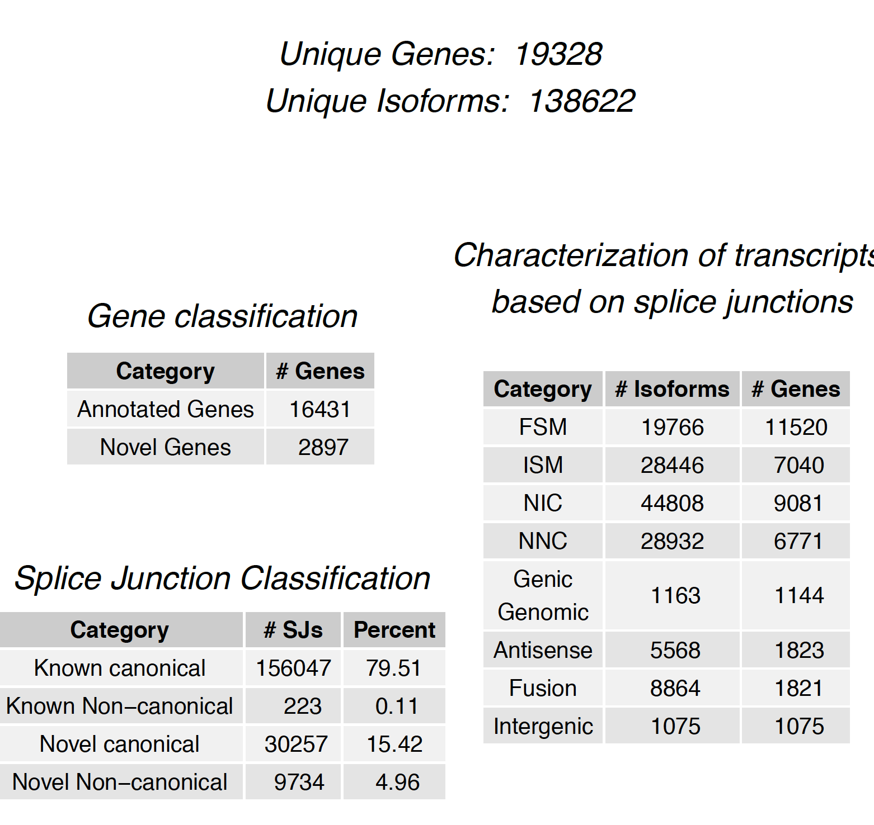
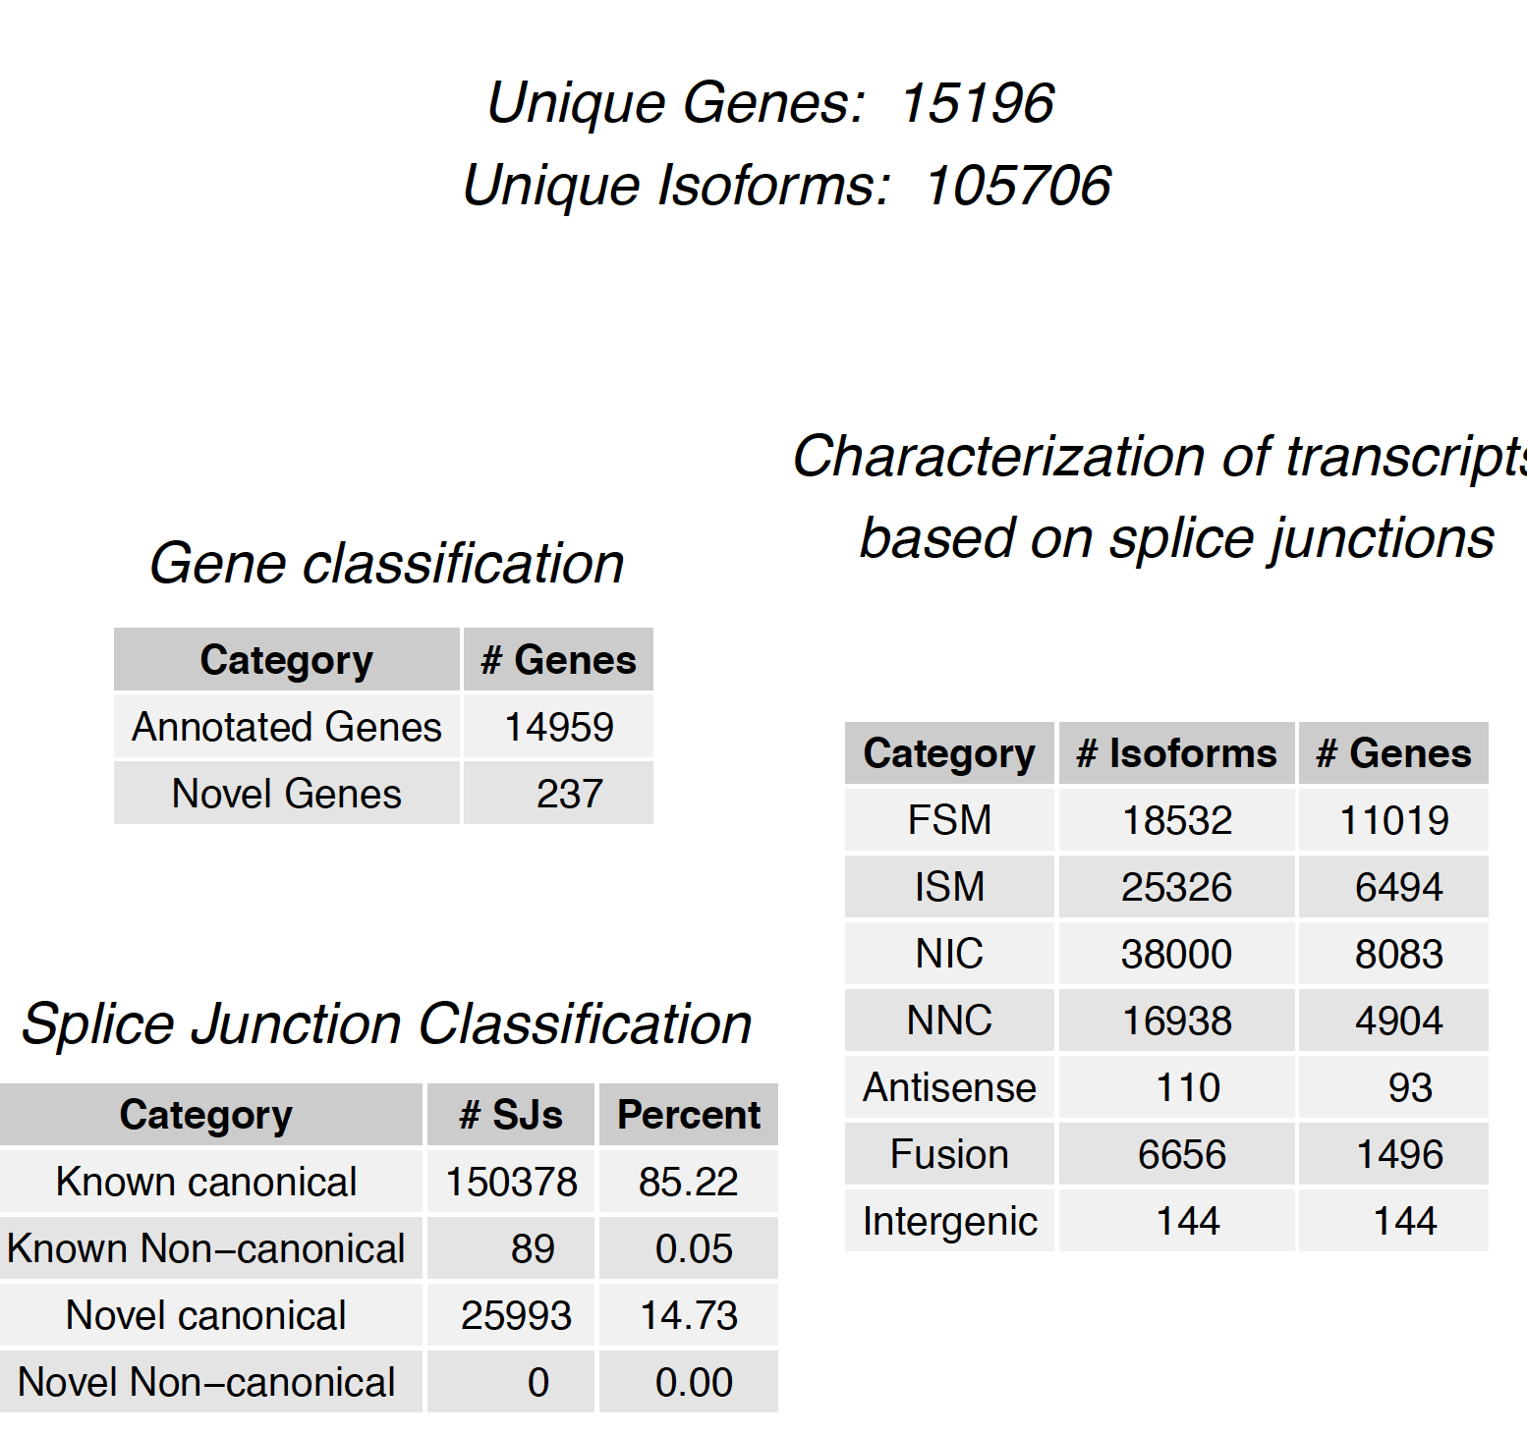
Sqanti2 before & after filtering
SQANTI2
filtering

Slide 15
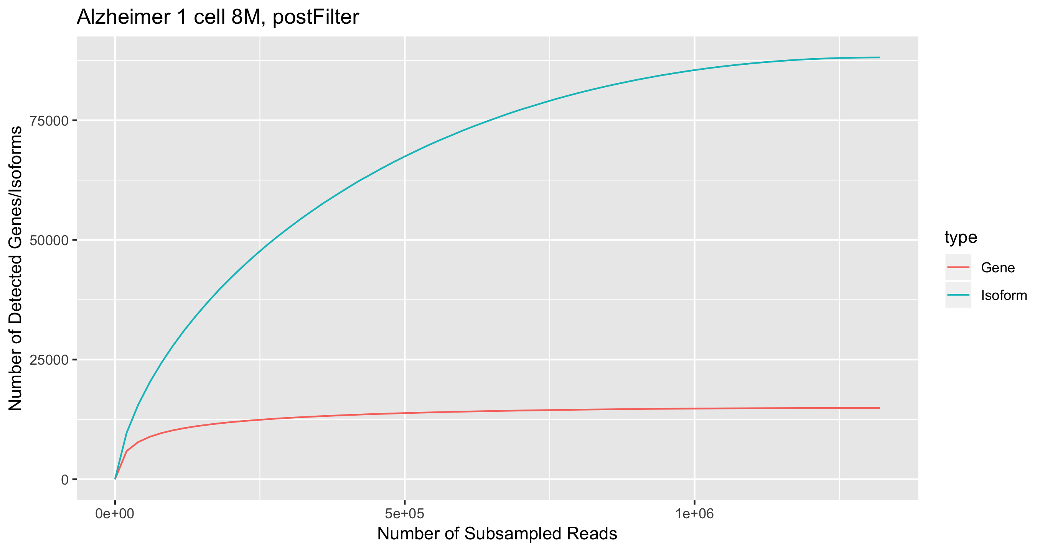
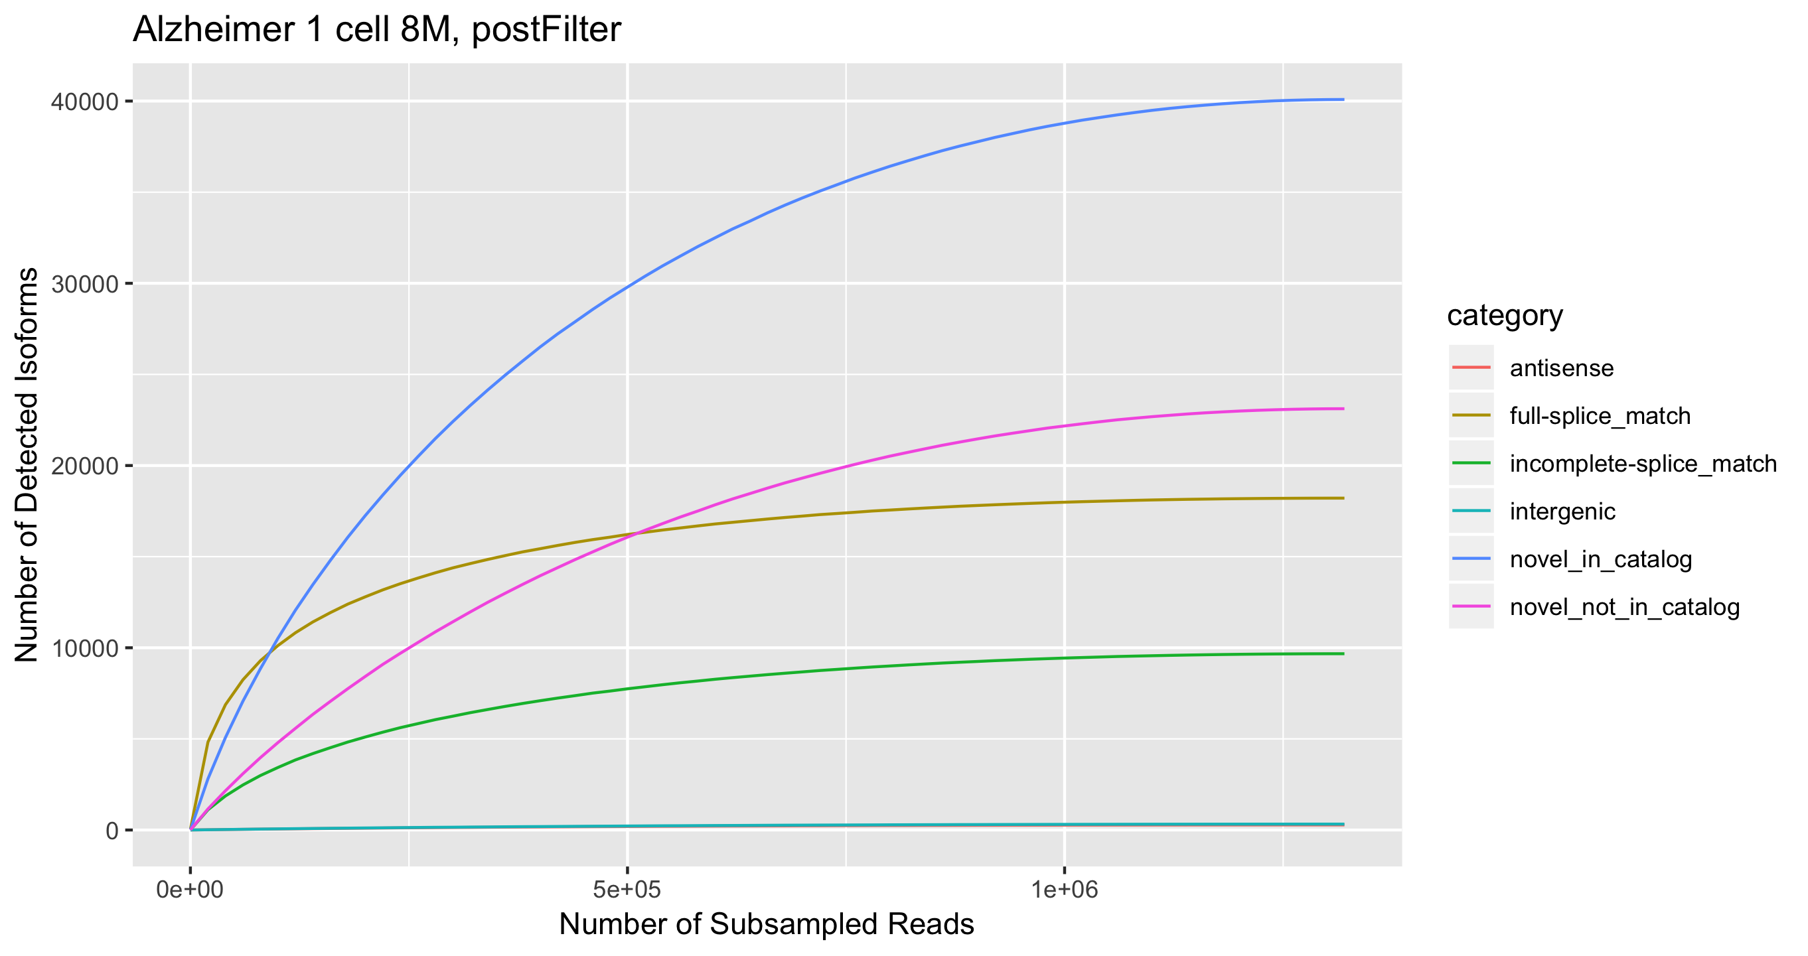
Rarefaction curves

Slide 16
Iso-seq online resources
pacb.com/applications/rna-sequencing/
tinyurl.com/isoseq-google
@PacBio @Magdoll
github.com/PacificBiosciences/IsoSeq
github.com/Magdoll

